Slide 1
Content
Definition of ML
History
Application of ML
Types of ML
Difference Between Types of M/c Learning
Problem Types of ML
Different types of data for machine

Slide 2
Content
Different approaches for Machine learning models
Algorithms for types of ML
Example of Supervised ,Unsupervised and reinforcement machine learning
Applications of ML
Different Use Cases for ML models
Different Terms uses in the machine learning models
Life Cycle of ML models

Slide 3
Machine learning (ML) is the study of computer algorithms that improve automatically through experience and by the use of data.
Its self learning process without explicitly involved any users. It learn from past data or experienced.

Slide 4
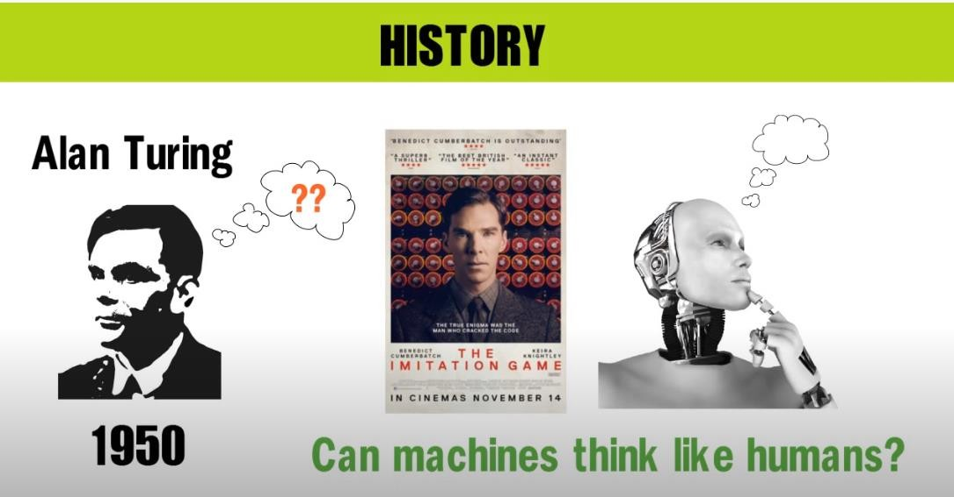
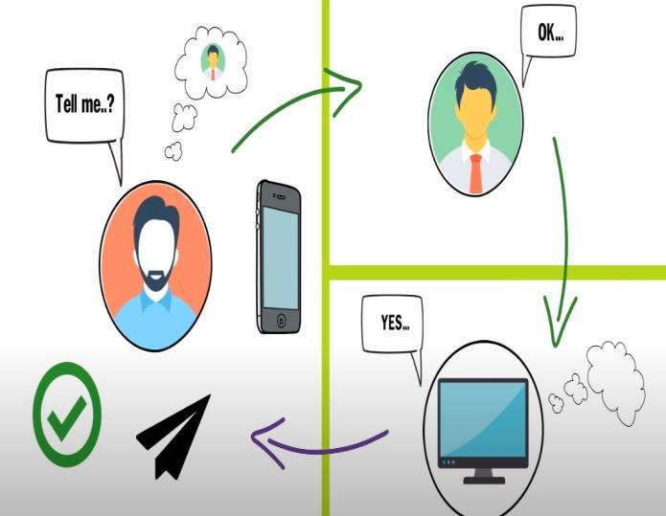
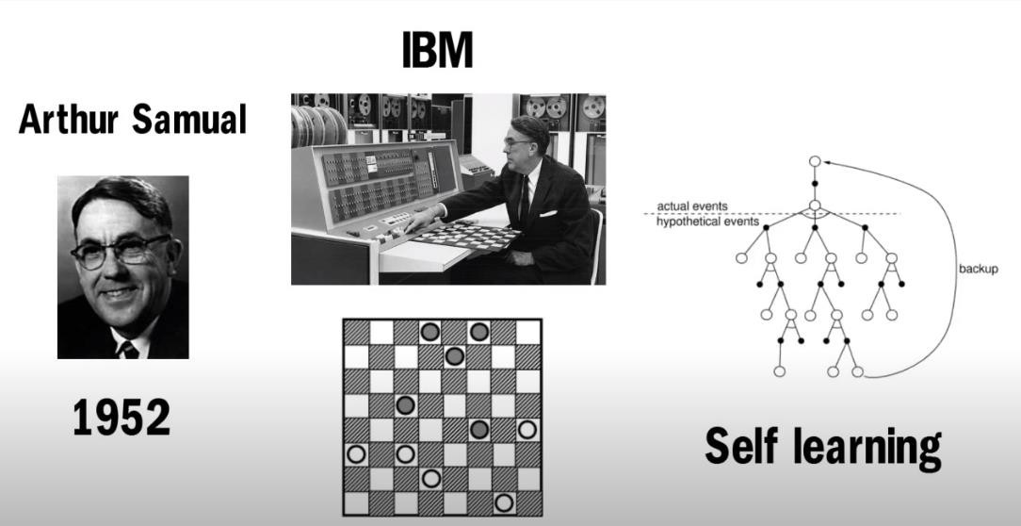
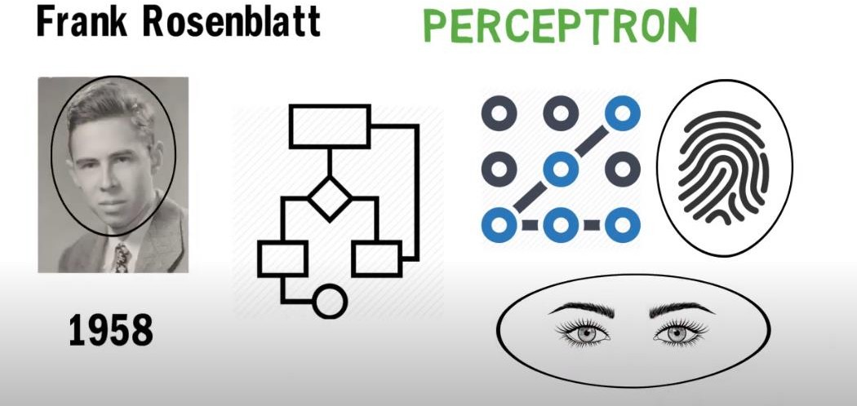
History

Slide 5
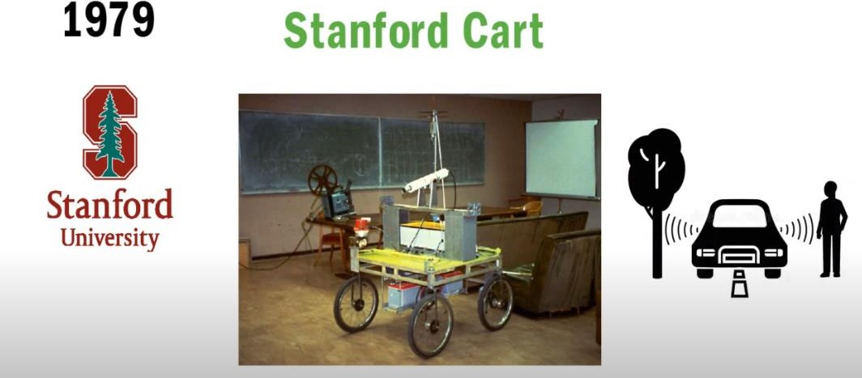
History
Stanford students built the Stanford Cart, a remotely-controlled, autonomous cart that could navigate on its own and avoid bumping into objects. It was designed to help study the remote control of a Moon rover.

Slide 6
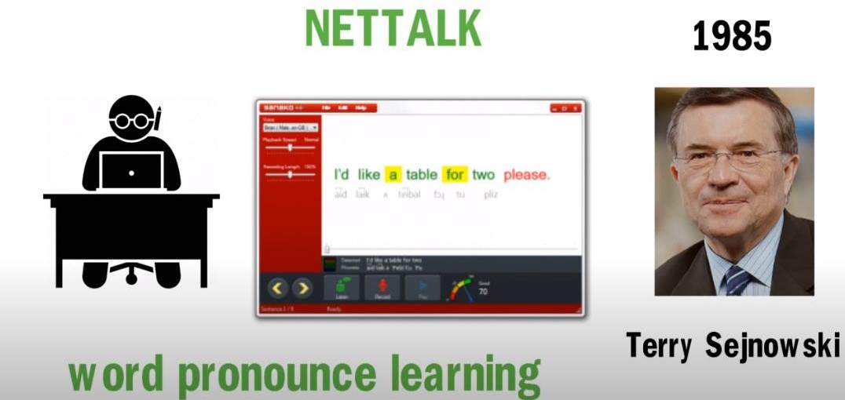
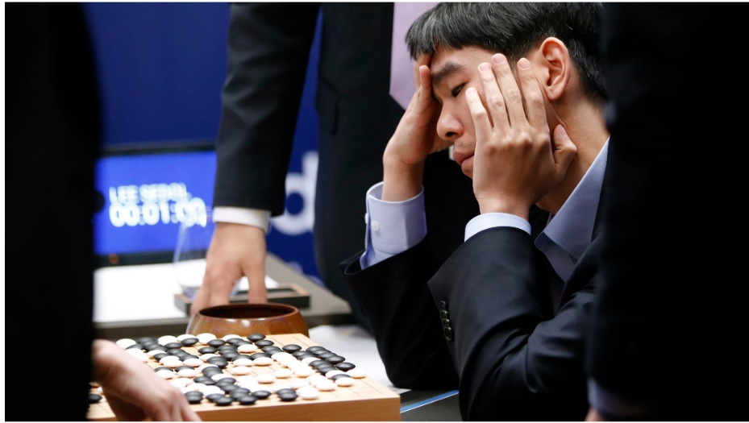
Terrence Sejnowski invented NETtalk, an ML-based computer program that could perform cognitive tasks like a human. With written English text and phonetic transcriptions as input, it learned to “talk” like a baby.
In October 2015, the distributed version of AlphaGo defeated the European Go champion Fan Hui, a 2-dan (out of 9 dan possible) professional, five to zero. This was the first time a computer Go program had beaten a professional human player on a full-sized board without handicap.

Slide 7
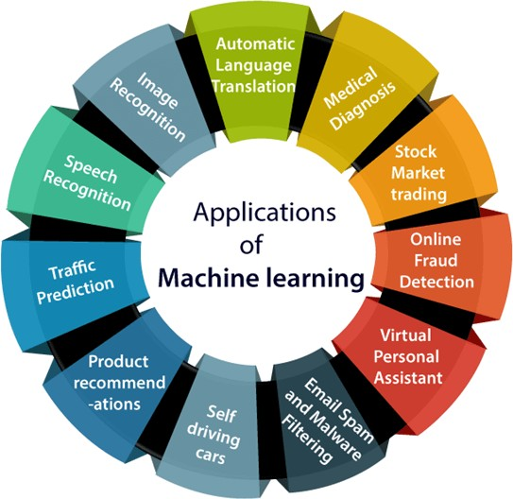
Application of M/C Learning

Slide 8
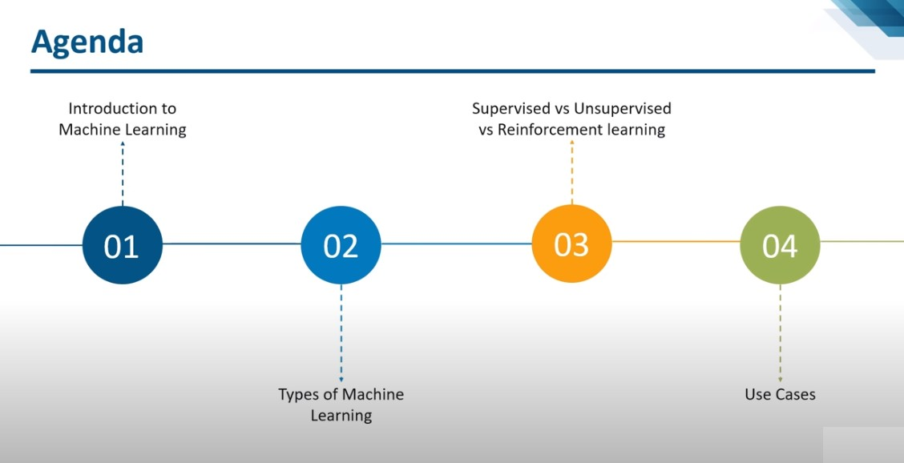

Slide 9
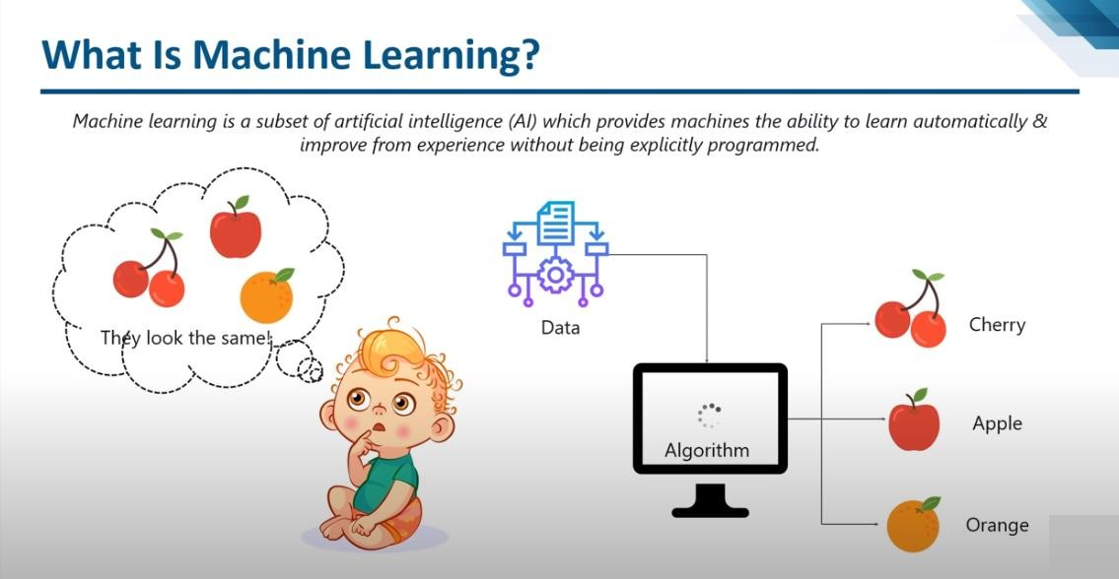

Slide 10
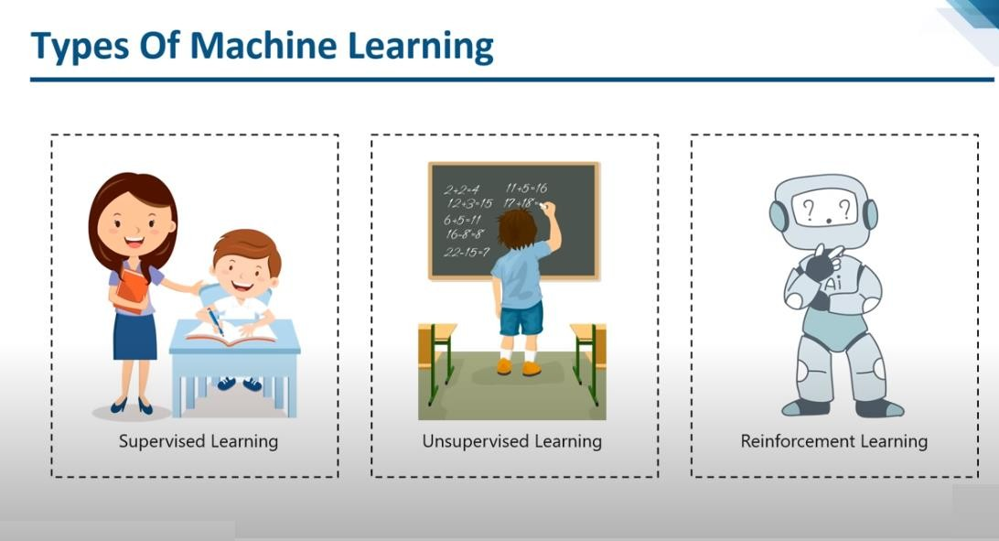

Slide 11
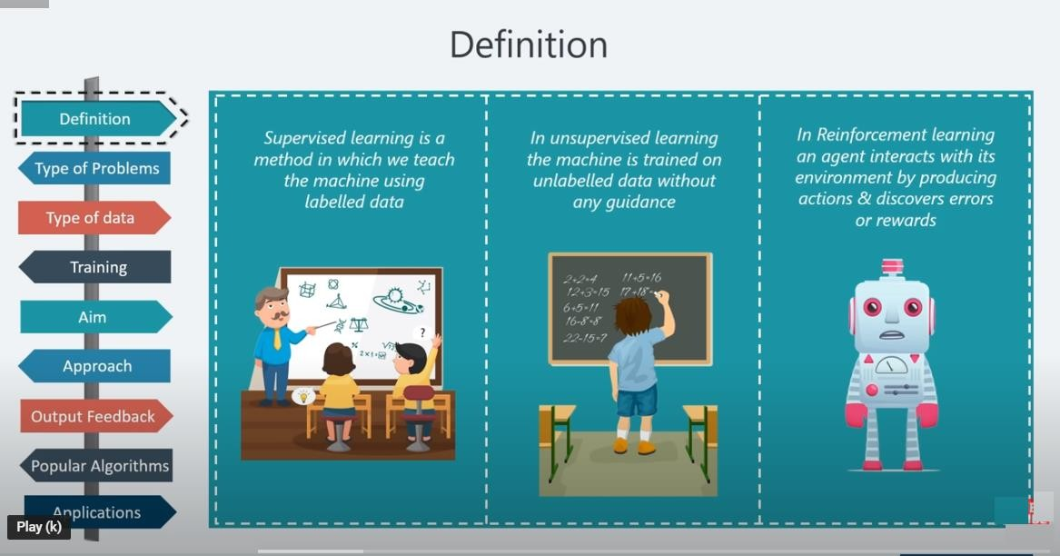
Difference Between Types of M/c Learning

Slide 12
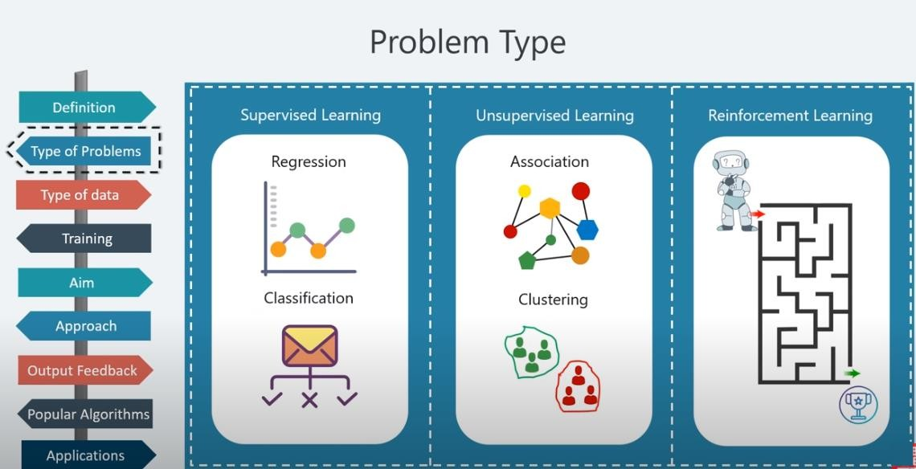
Problem Types

Slide 13
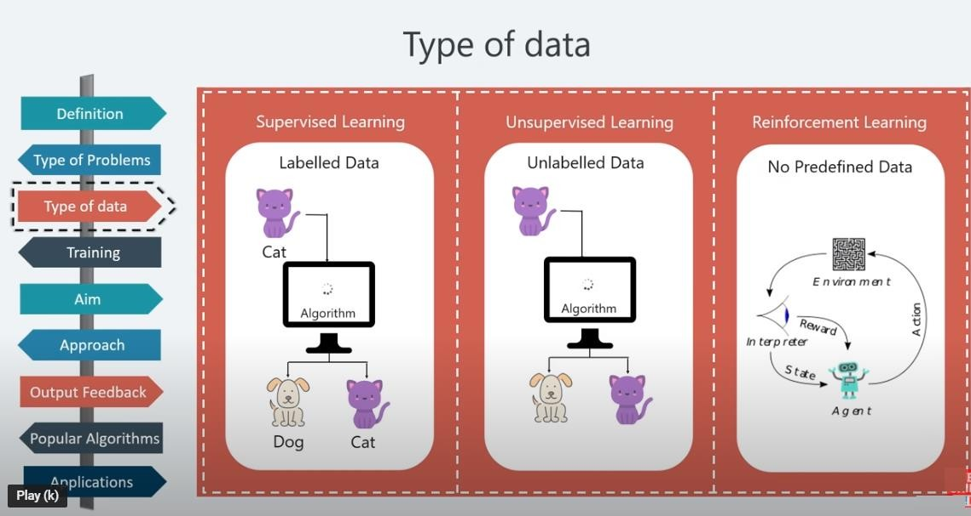
Types of Data

Slide 14
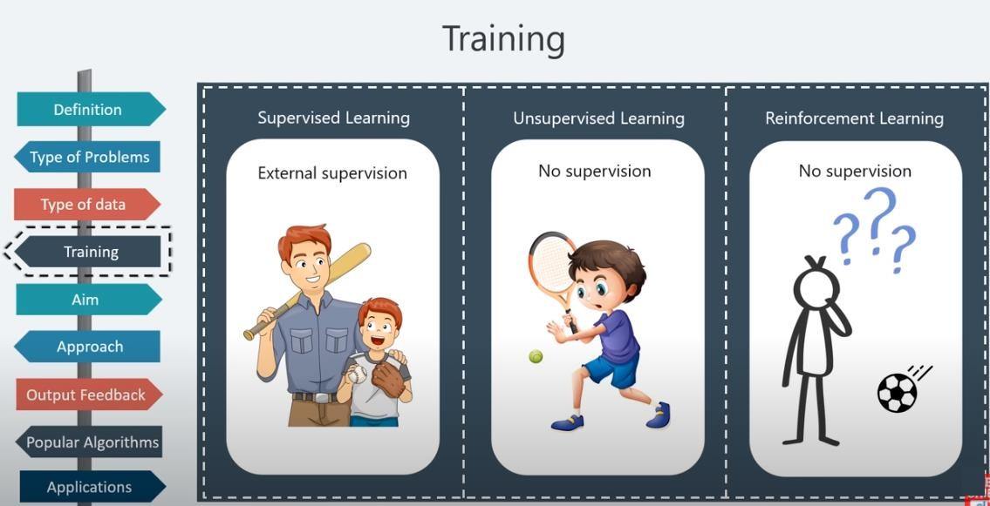
Training

Slide 15
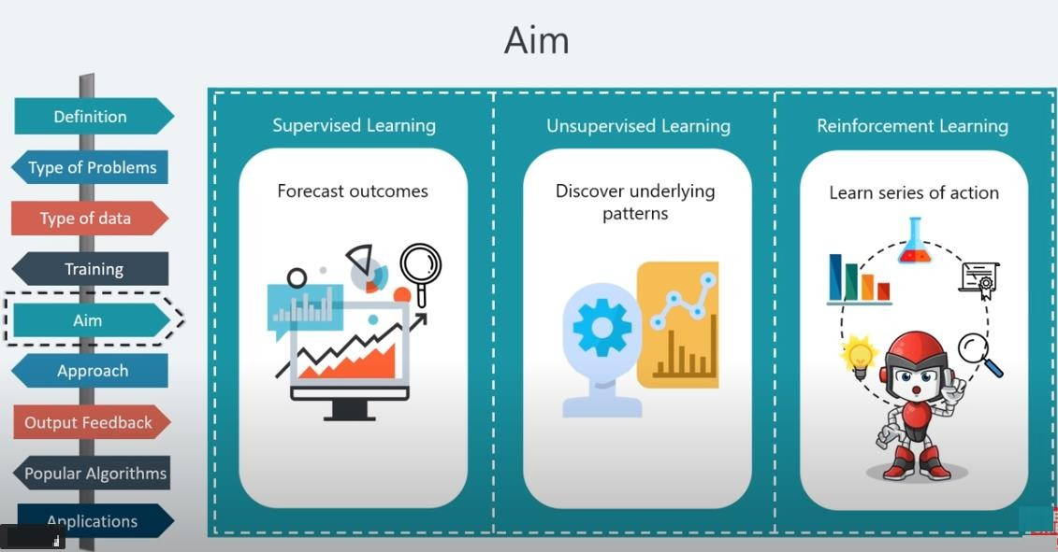
Aim

Slide 16
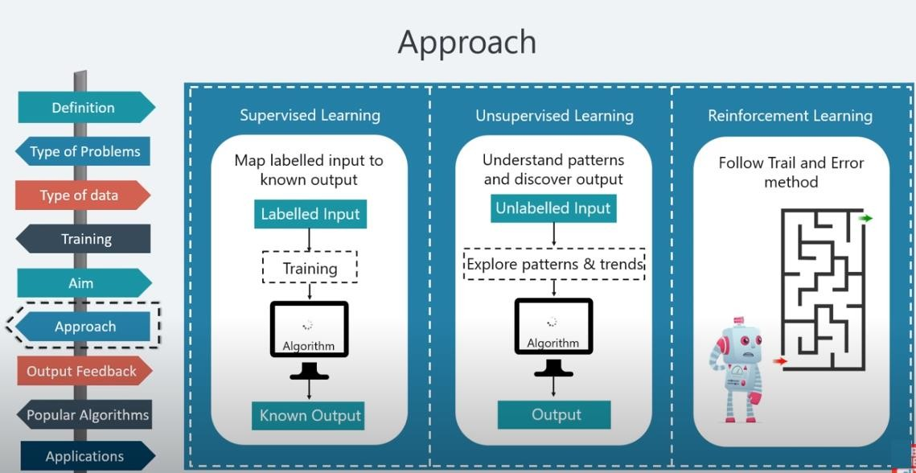
Approach

Slide 17
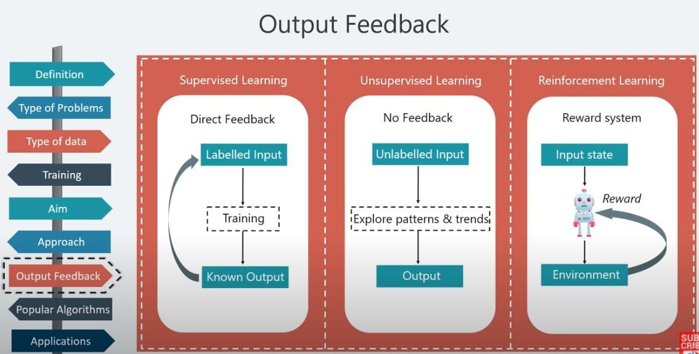
Approach

Slide 18
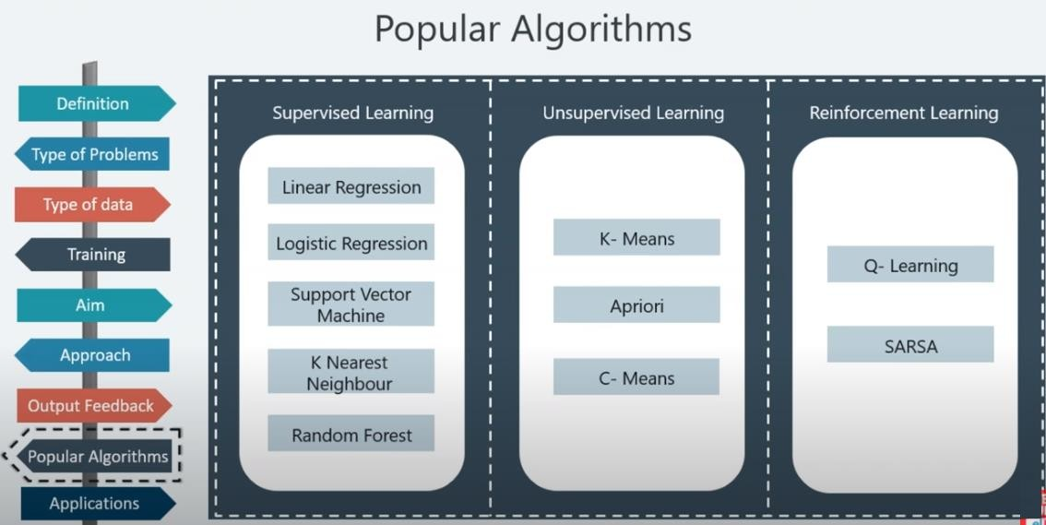
Algorithms

Slide 19
Real Life Example of Supervised machine learning
Email Filtering
Image Classification
Fraud Detection
Visual Recognition
Different recommendations system :
Amazon, Facebook, Google, Netflix, Youtube, Contains supervised learning techniques.

Slide 20
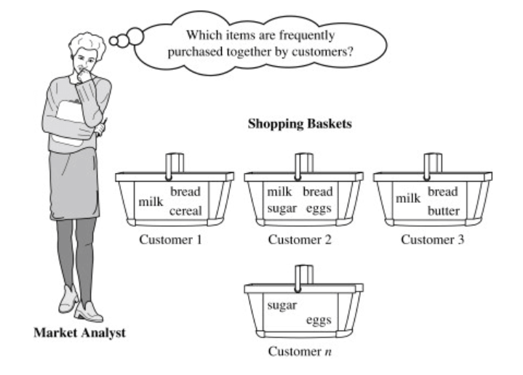
Real Life Example of Unsupervised machine learning

Slide 21
Real Life Example of Reinforcement machine learning
Robots equipped with visual sensors from to learn their surrounding environment
Traffic analysis and real-time road processing by video segmentation and frame-by-frame image processing
CCTV cameras for traffic and crowd analytics
Scanners to understand and interpret text

Slide 22
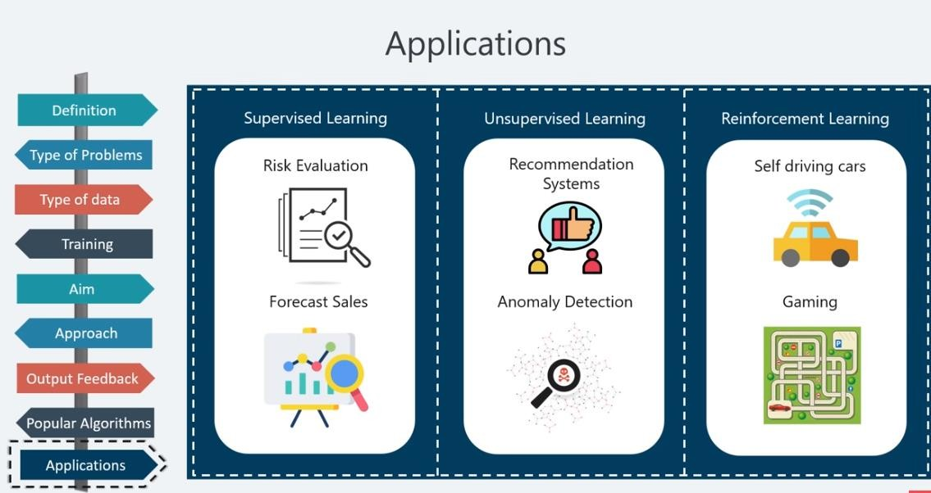
Applications

Slide 23
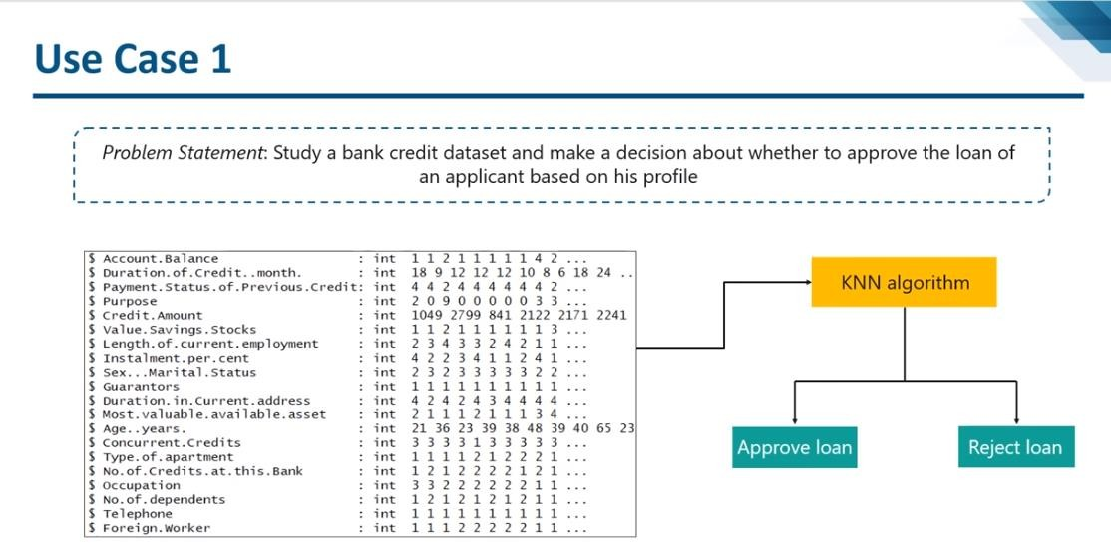
Use Cases
https://colab.research.google.com/drive/1cuKljFSMx3eDm3_LTyh-OjlUs4nlQYdf#scrollTo=x2RUPvunWH0E

Slide 24
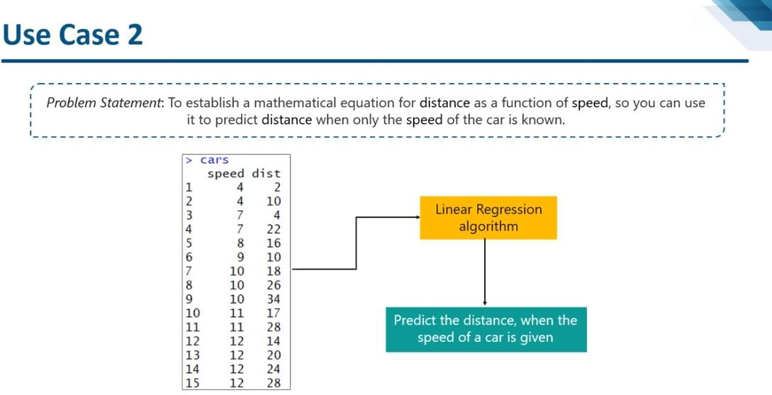
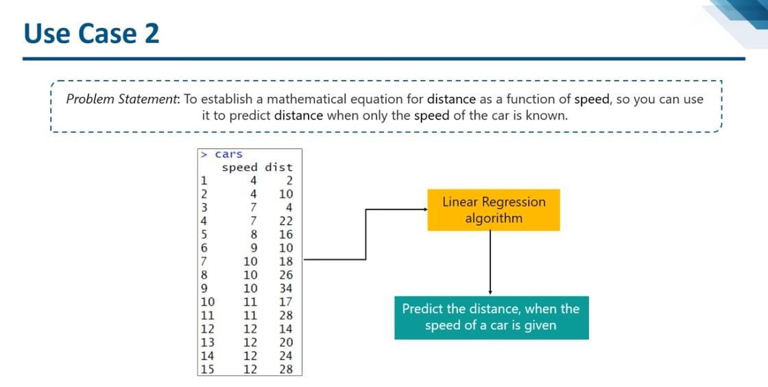
Use Cases
https://colab.research.google.com/drive/1cuKljFSMx3eDm3_LTyh-OjlUs4nlQYdf?usp=sharing

Slide 25
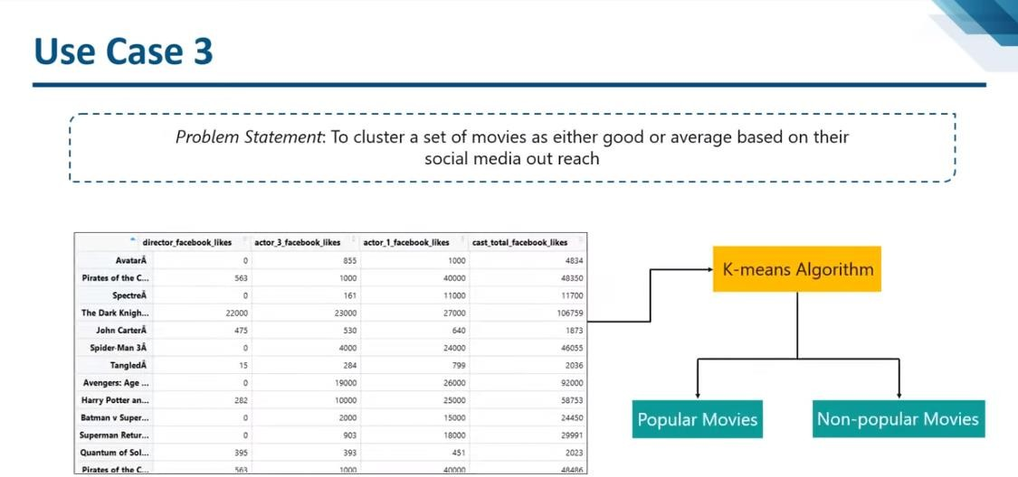
Use Cases

Slide 26
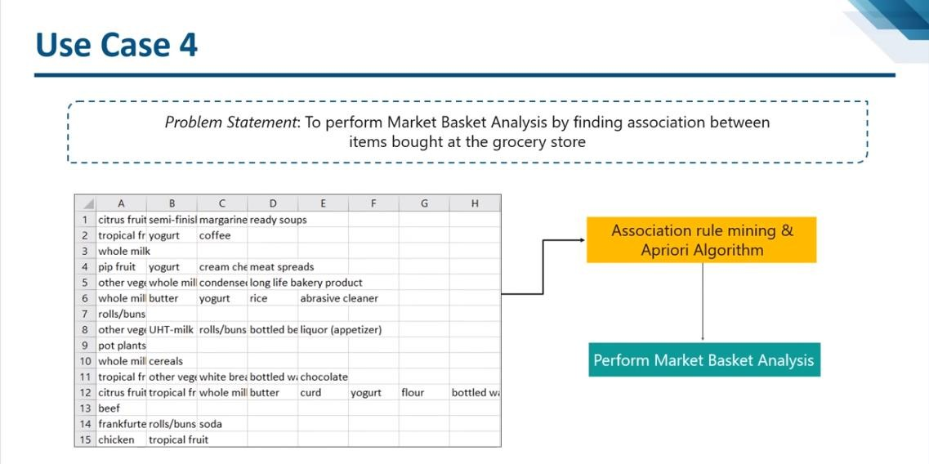
Use Cases

Slide 27
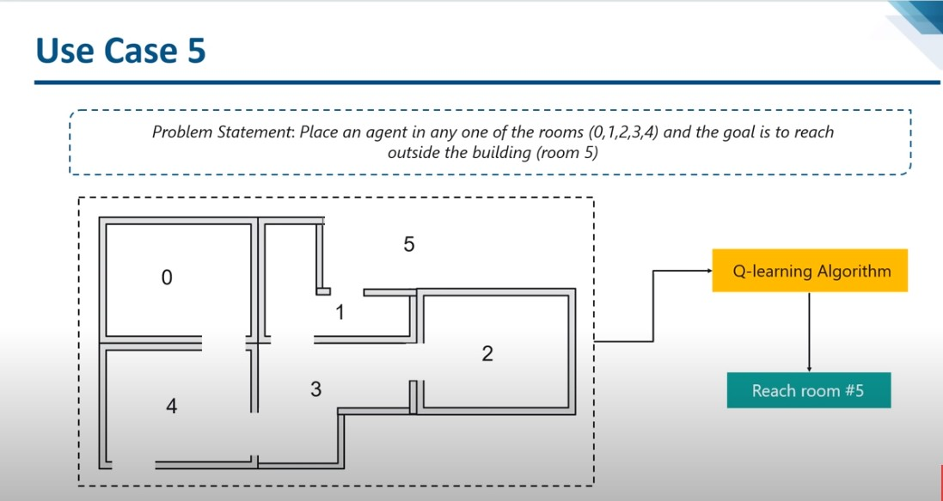
Use Cases

Slide 28
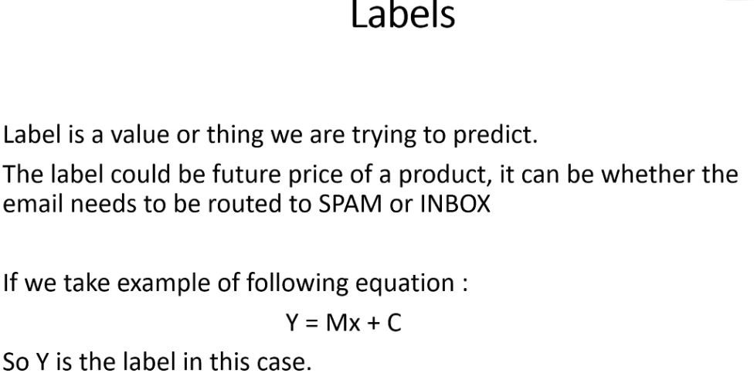
Terms………

Slide 29
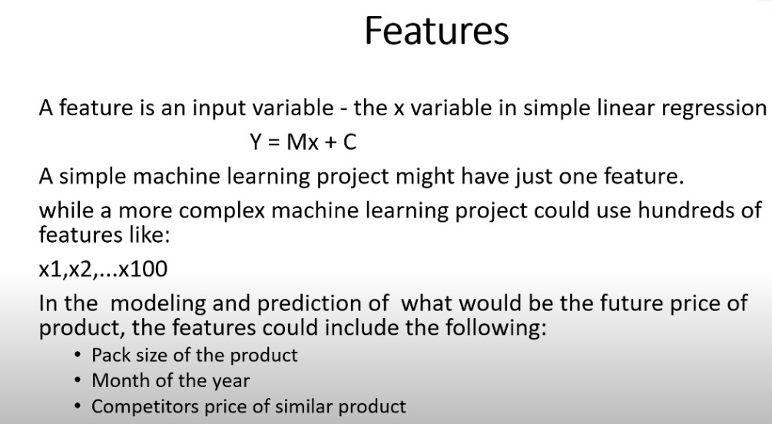
Terms………

Slide 30
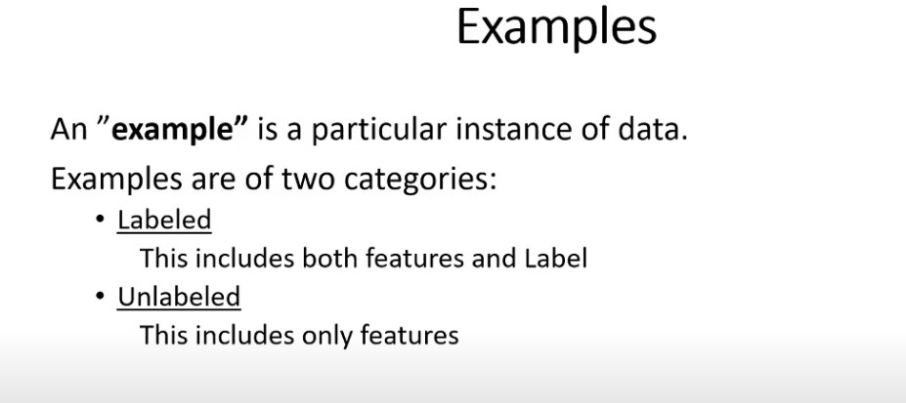
Terminologies………

Slide 31
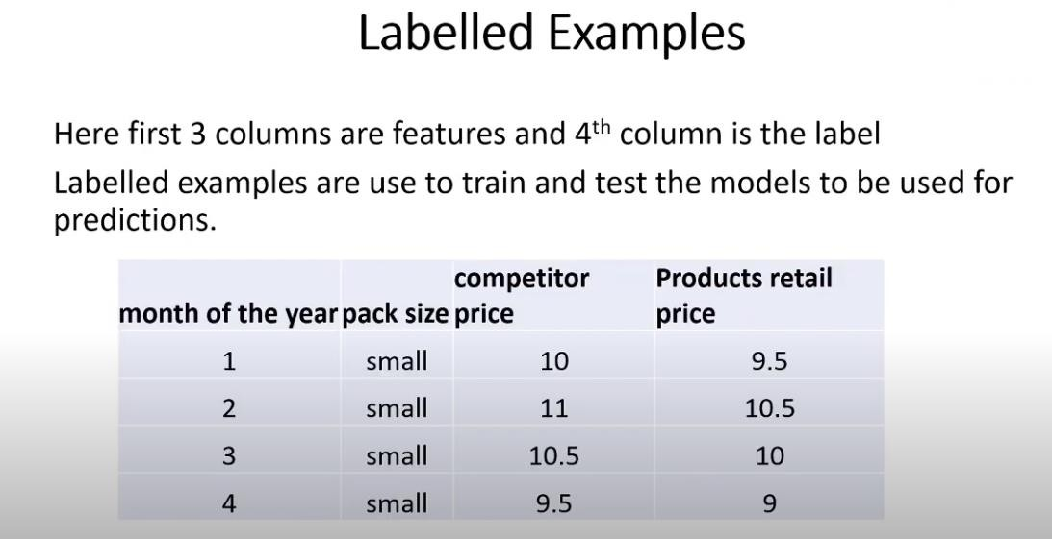
Terminologies………

Slide 32
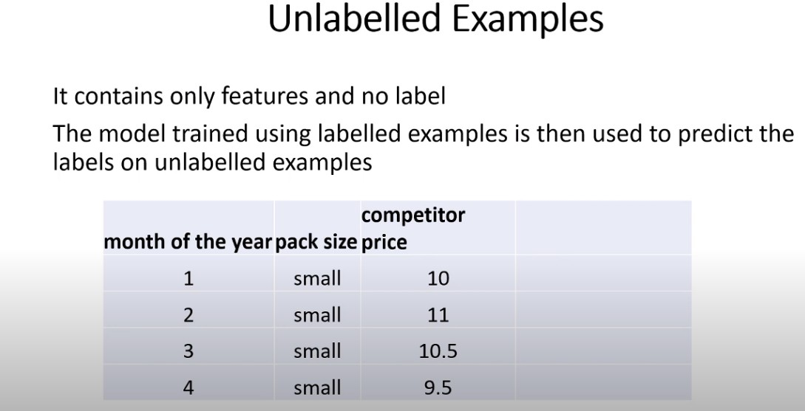
Terminologies………

Slide 33
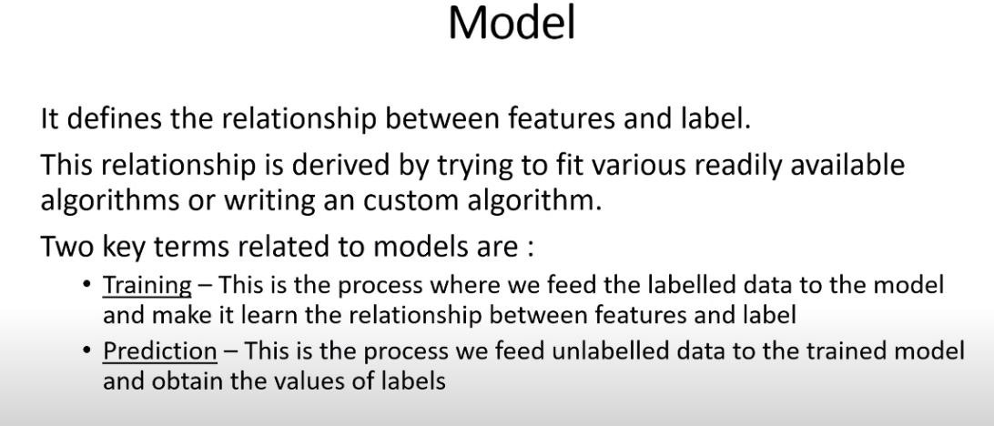
Terminologies………

Slide 34
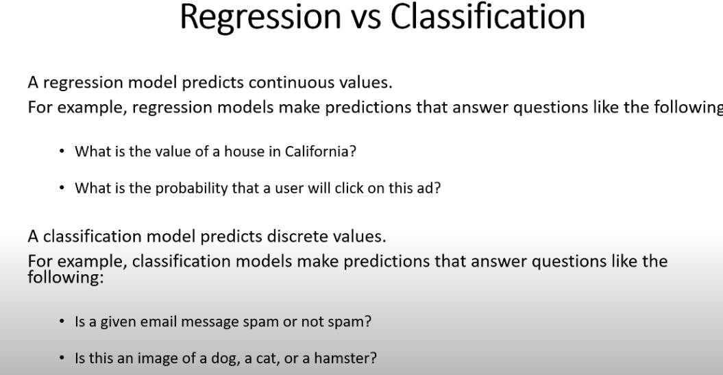
Terminologies………

Slide 35
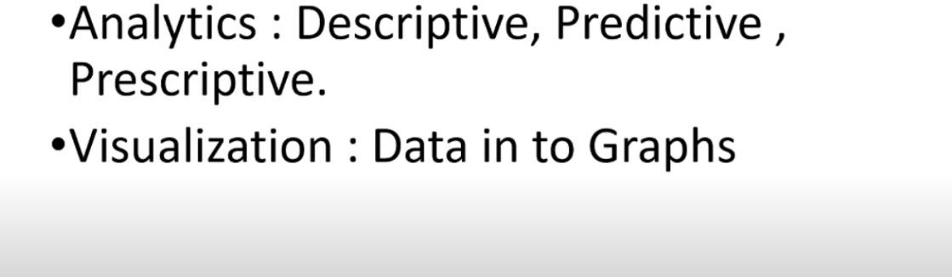
Terminologies………

Slide 36
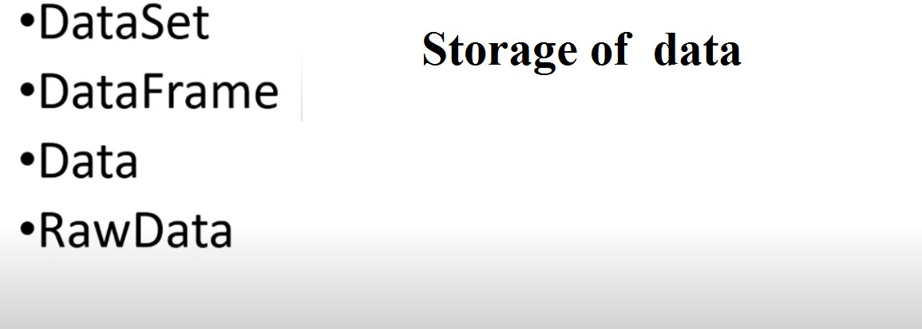
Terminologies………

Slide 37
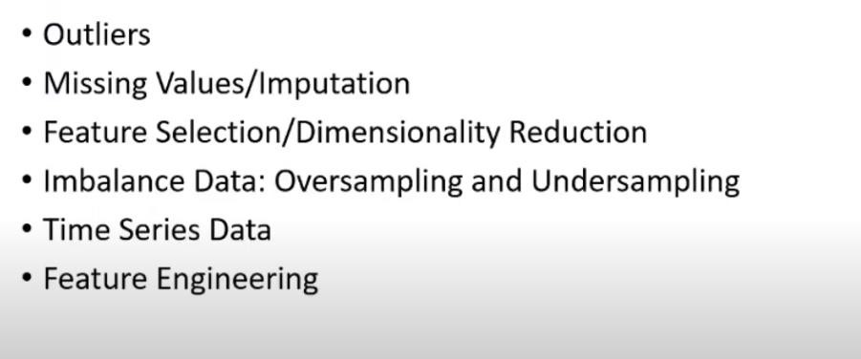
Terminologies………

Slide 38
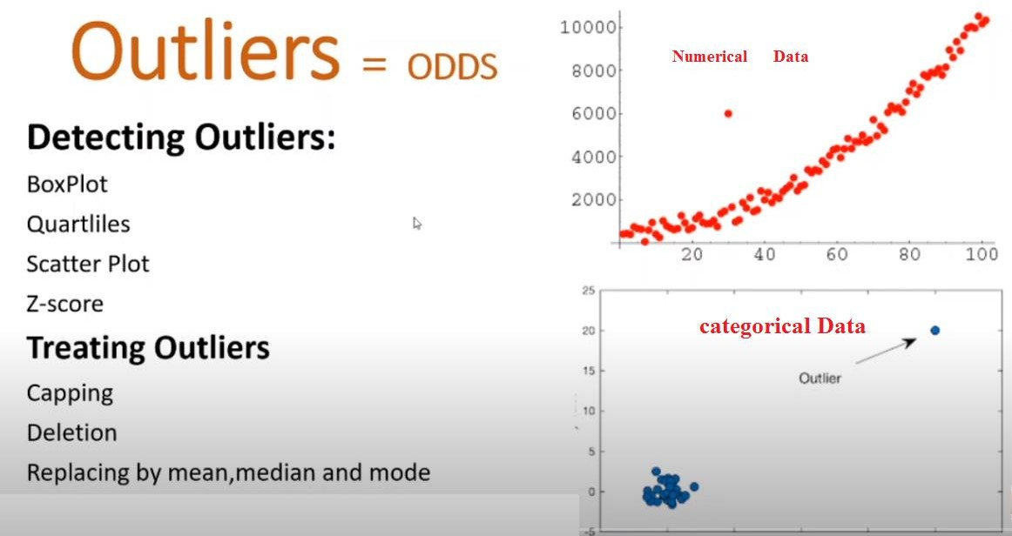
Terminologies………

Slide 39
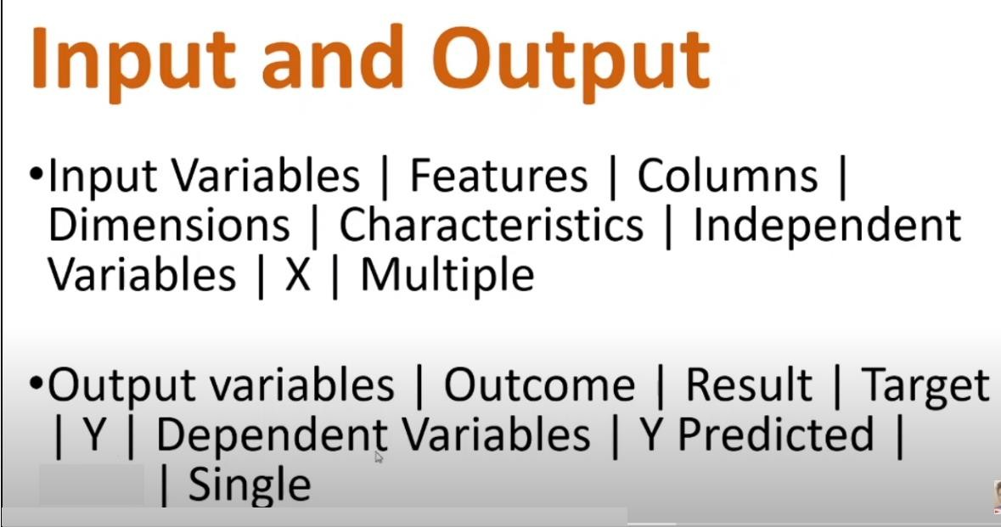
Terminologies………

Slide 40
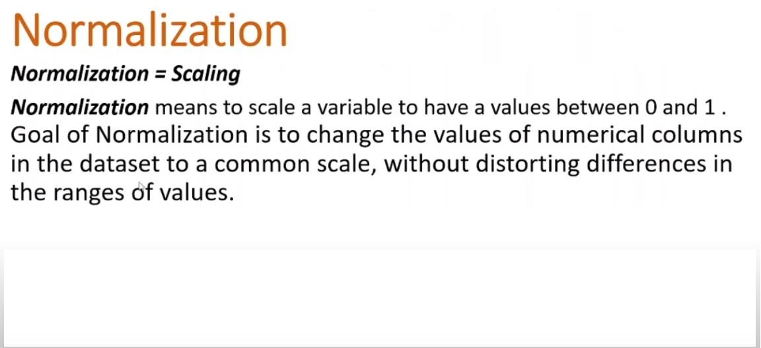
Terminologies………

Slide 41
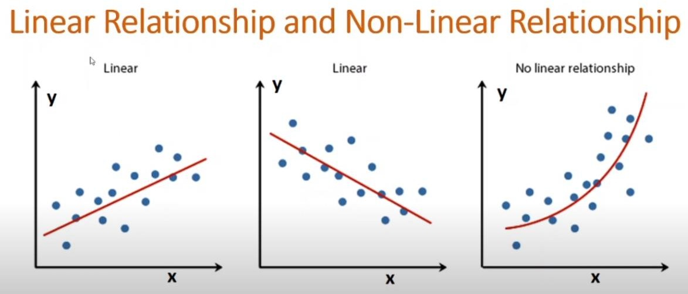
Terminologies………

Slide 42
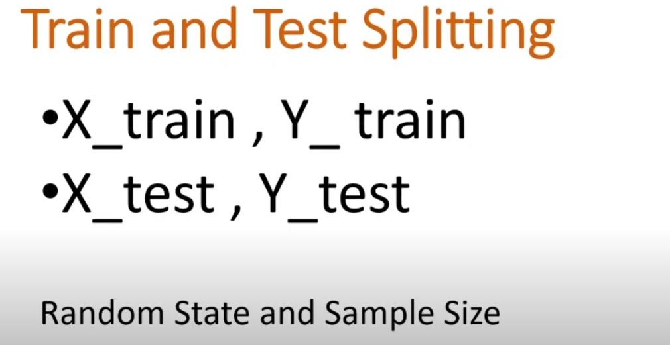
Terminologies………

Slide 43
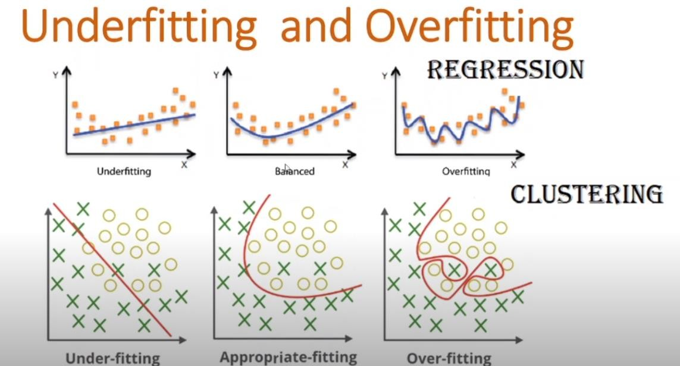
Terminologies………

Slide 44
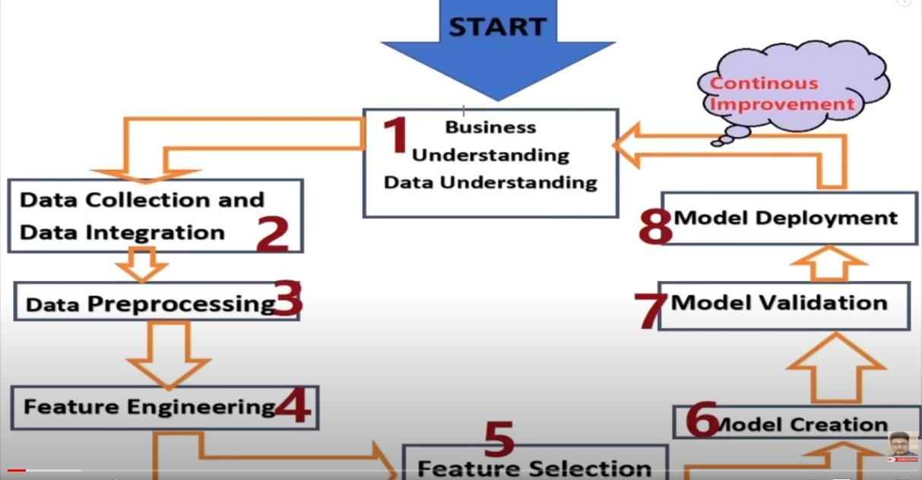
Life Cycle

Slide 45
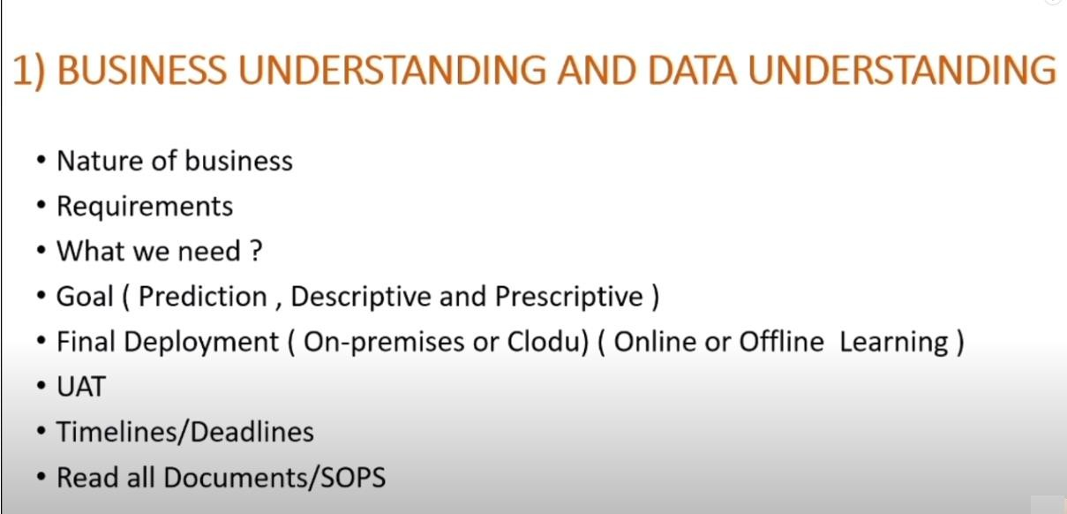
Conti….

Slide 46
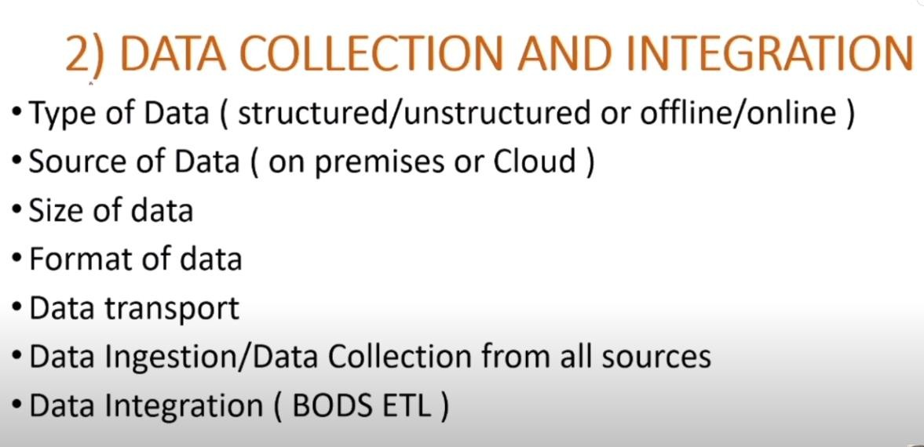
Conti……..

Slide 47
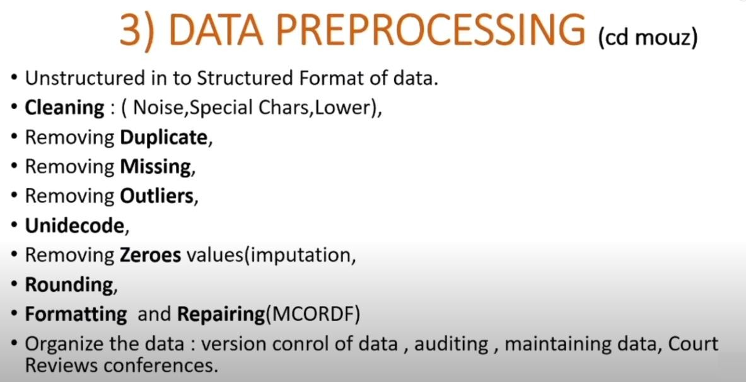
Conti….

Slide 48
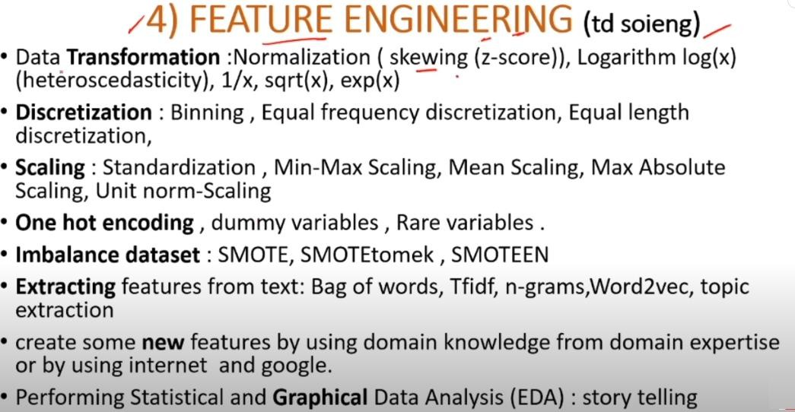
Conti……..

Slide 49
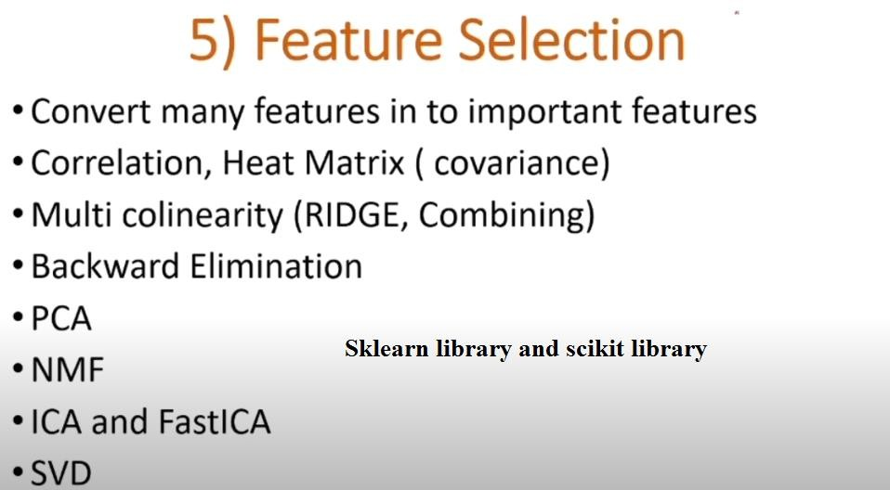
Conti….

Slide 50
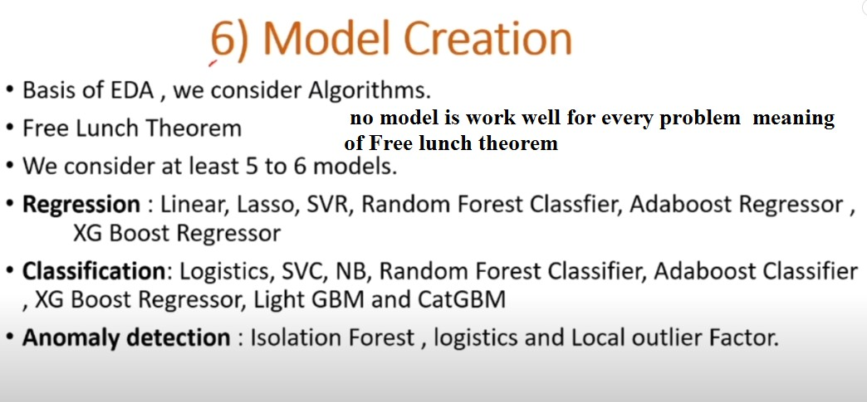
Conti…..

Slide 51

Conti………

Slide 52

Conti………..

Slide 53

Conti………

Slide 54
Scikit-learn
Scikit-learn (Sklearn) is the most useful and robust library for machine learning in Python. It provides a selection of efficient tools for machine learning and statistical modeling including classification, regression, clustering and dimensionality reduction via a consistence interface in Python. This library, which is largely written in Python, is built upon NumPy, SciPy and Matplotlib.
•

Slide 55
Features
Rather than focusing on loading, manipulating and summarising
data, Scikit-learn library is focused on modeling the data. Some of
the most popular groups of models provided by Sklearn are as follows −
Supervised Learning algorithms − Almost all the popular
supervised learning algorithms, like Linear Regression, Support
Vector Machine (SVM), Decision Tree etc., are the part of scikit- learn.
Unsupervised Learning algorithms − On the other hand, it also
has all the popular unsupervised learning algorithms from
clustering, factor analysis, PCA (Principal Component Analysis) to unsupervised neural networks.
Clustering − This model is used for grouping unlabeled data.
Cross Validation − It is used to check the accuracy of supervised
models on unseen data.

Slide 56
Continue
Dimensionality
Reduction − It is used for
reducing the number of attributes in data which can be further used for summarisation, visualisation and feature selection.
Ensemble methods − As name suggest, it is used for combining the predictions of multiple supervised models.
Feature extraction − It is used to extract the features from data to define the attributes in image and text data.
Feature selection − It is used to identify useful attributes to create supervised models.

Slide 57
Dataset Loading
A collection of data is called dataset. It is having the following two components −
Features − The variables of data are called its features. They are also
known as predictors, inputs or attributes.
Feature matrix − It is the collection of features, in case there are more than one.
Feature Names − It is the list of all the names of the features.
Response − It is the output variable that basically depends upon the
feature variables. They are also known as target, label or output.
Response Vector − It is used to represent response column. Generally, we have just one response column.
Target Names − It represent the possible values taken by a response
vector.
Scikit-learn have few example datasets like iris and digits for classification and the Boston house prices for regression.

Slide 58


